Slide 1
What Does a Toolchain for Automating Legislation Eventually Become?
Davin Fifield – VP Product Development, Oracle
Surend Dayal – Partner, Deloitte; Senior Lecturer (Hon.), Australian National University
Don Syme – Principal Researcher, Microsoft (1998-); SoftLaw (1990-91)

Slide 2
Hey, let’s do a programming language for the law!
The forces of Time, Destiny, Reality, Practicality, Market, Longevity, Opportunity
???
2
Notes:
[Don]

Slide 3
Hey, let’s do a toolchain for automating administrative law!
The forces of Time, Destiny, Reality, Practicality, Market, Longevity, Opportunity
???
1989
2022
3

Slide 4
Evolution
1989 – 1993
STATUTE Inference Machine; Rulebase Workshop
1994 – 2002
STATUTE Expert
2003 – 2008
RuleBurst; New non-RETE algorithm
2009 – 2019
Oracle Policy Automation
2020 – present
Oracle Intelligent Advisor

Slide 5
The Origins - STATUTE

Slide 6
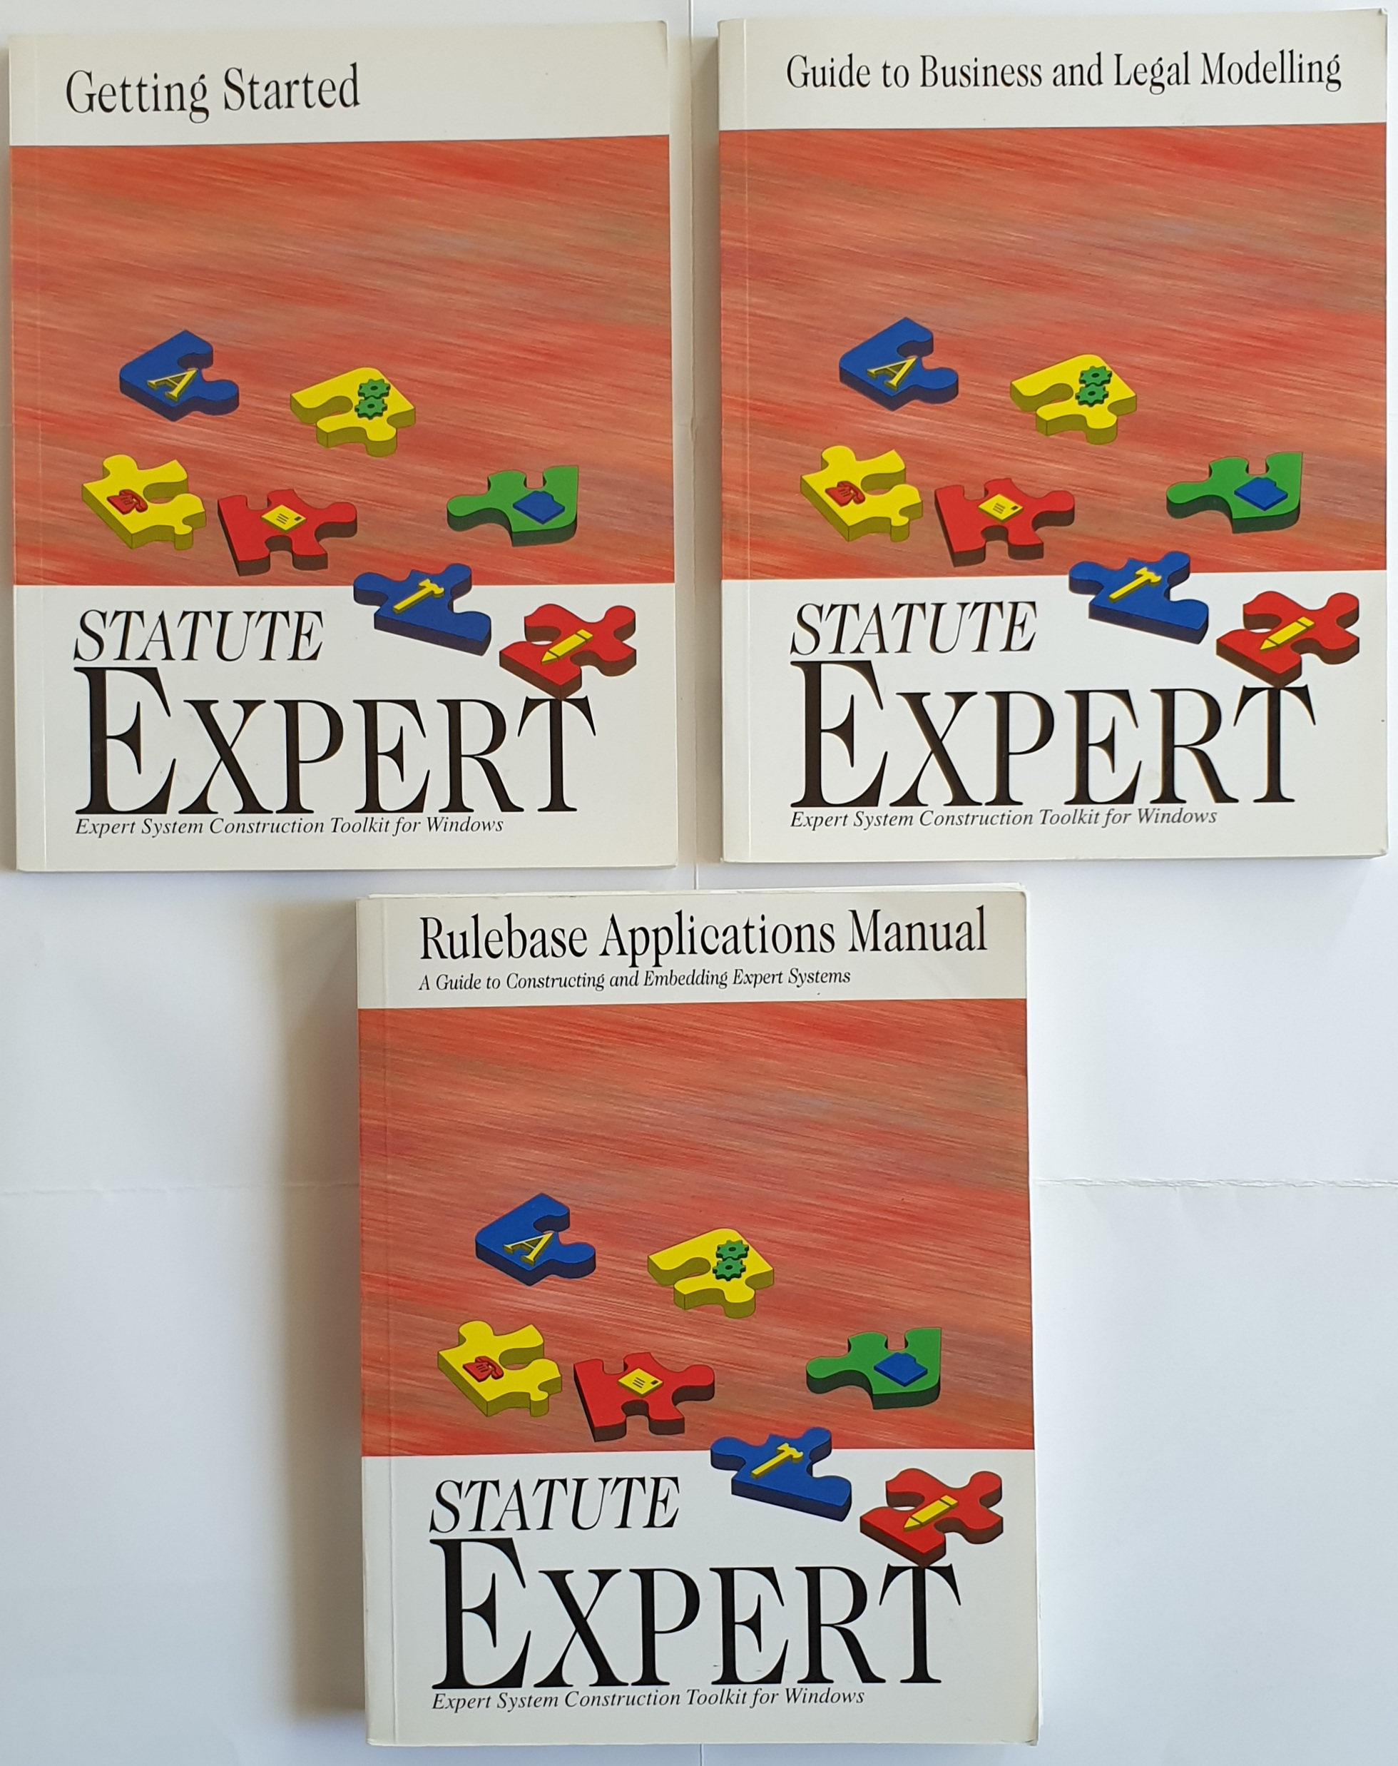
1990s - STATUTE
For direct use by administrative lawyers
Cut the programmers out of the loop
Targeted to maintaining legislation under change
Knowledge represented using limited natural language
Peter Johnson
Administrative Lawyer
“The Annotated Social Security Act 1989”
David Mead
Computer Programmer
6
Notes:
[Don]

Slide 7
1990s – STATUTE Programming Model
You’re authoring a “Rulebase Application”
The “Program” is logical rules in limited natural language
The “IDE” helps you build and maintain this program
The “Runtime Engine” knows how to
collect facts
manipulate limited natural language, e.g. ask questions
generate practical interviews , decisions, reports
“Deployment” into Windows, later Web
7
Notes:
[Don]
5 minutes – 7:30am Canberra (8:30pm London)

Slide 8
Practical isomorphism – source legislation
Division 1—Eligibility for family tax benefit
Subdivision A—Eligibility of individuals for family tax benefit in normal circumstances
21 When an individual is eligible for family tax benefit in normal circumstances
(1) An individual is eligible for family tax benefit if:
(a) the individual:
(i) has at least one FTB child; or
(ii) has at least one regular care child who is also a rent assistance child; and
(b) the individual:
(i) is an Australian resident; or
(ia) is a special category visa holder residing in Australia; or
(ii) satisfies subsection (1A); and
(c) the individual’s rate of family tax benefit is greater than nil.
Notes:
[Surend]

Slide 9
Practical isomorphism – modelled rules
Notes:
[Surend]

Slide 10
“Practical isomorphism” = maintenance under change
Legislation/Interpretation/Policy
Rules
Δ
Δ
Legislation’/Interpretation’/Policy’
Rules’
10
Notes:
[Surend]

Slide 11
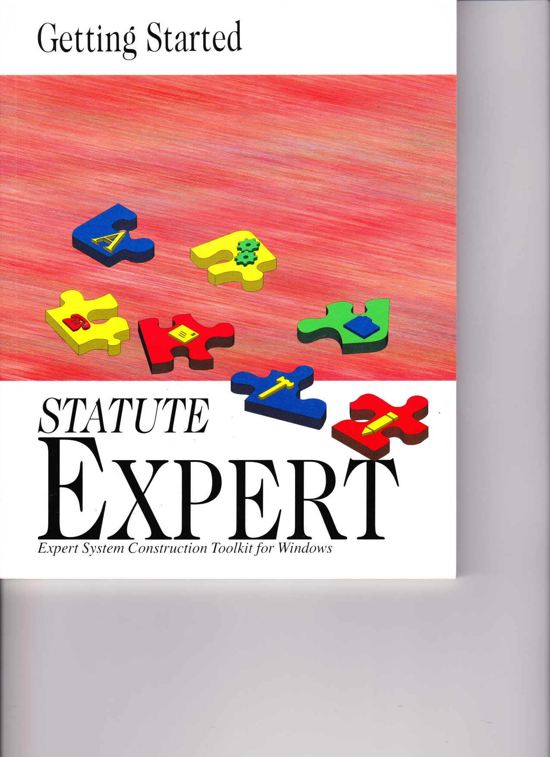
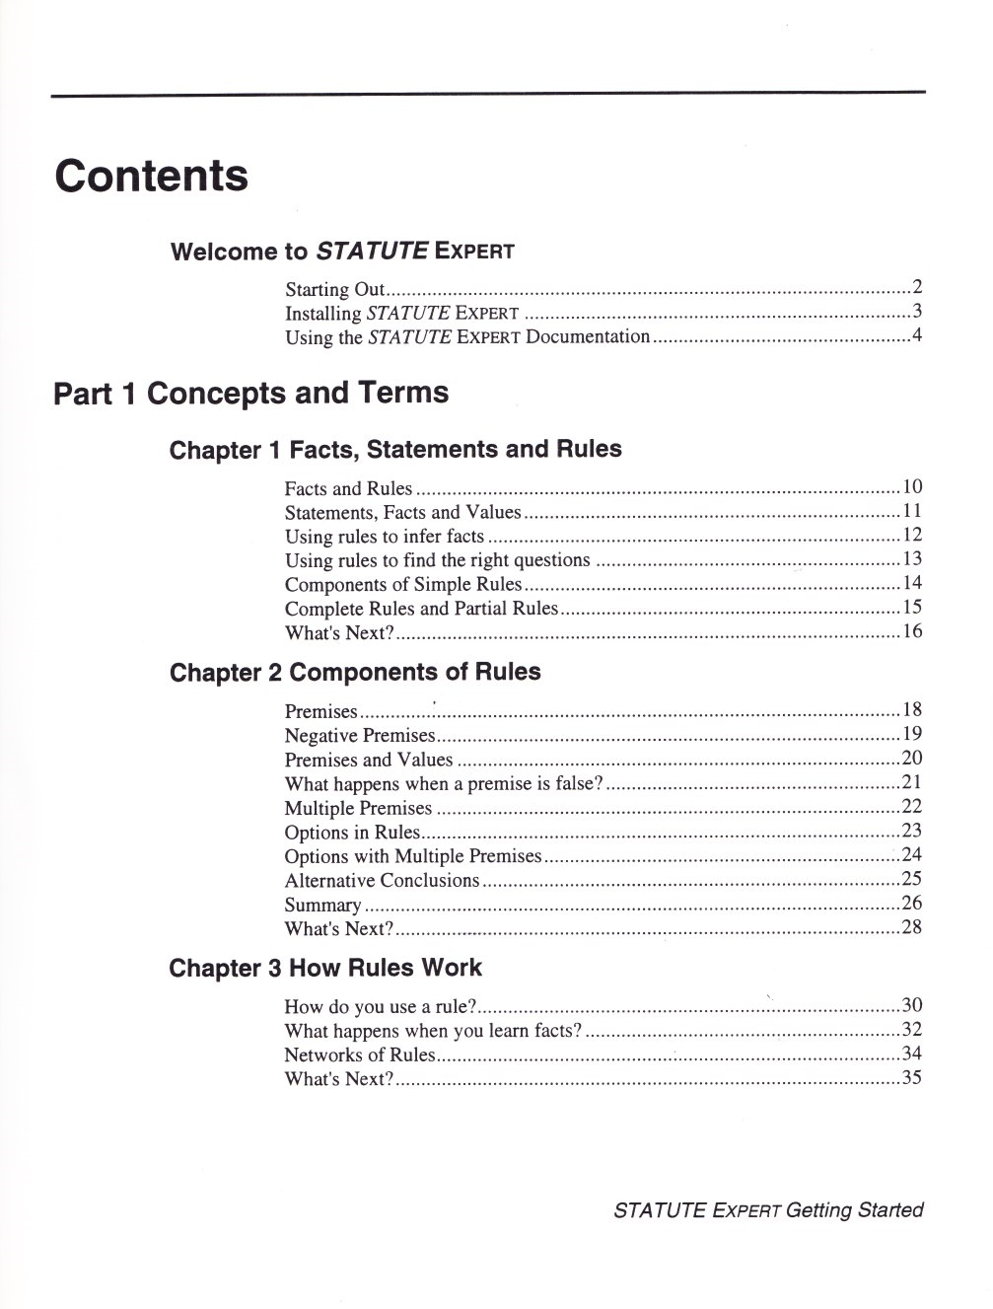
https://github.com/dsyme/ProLaLa2022/tree/main/STATUTE%20Expert
11
Notes:
[Surend]

Slide 12
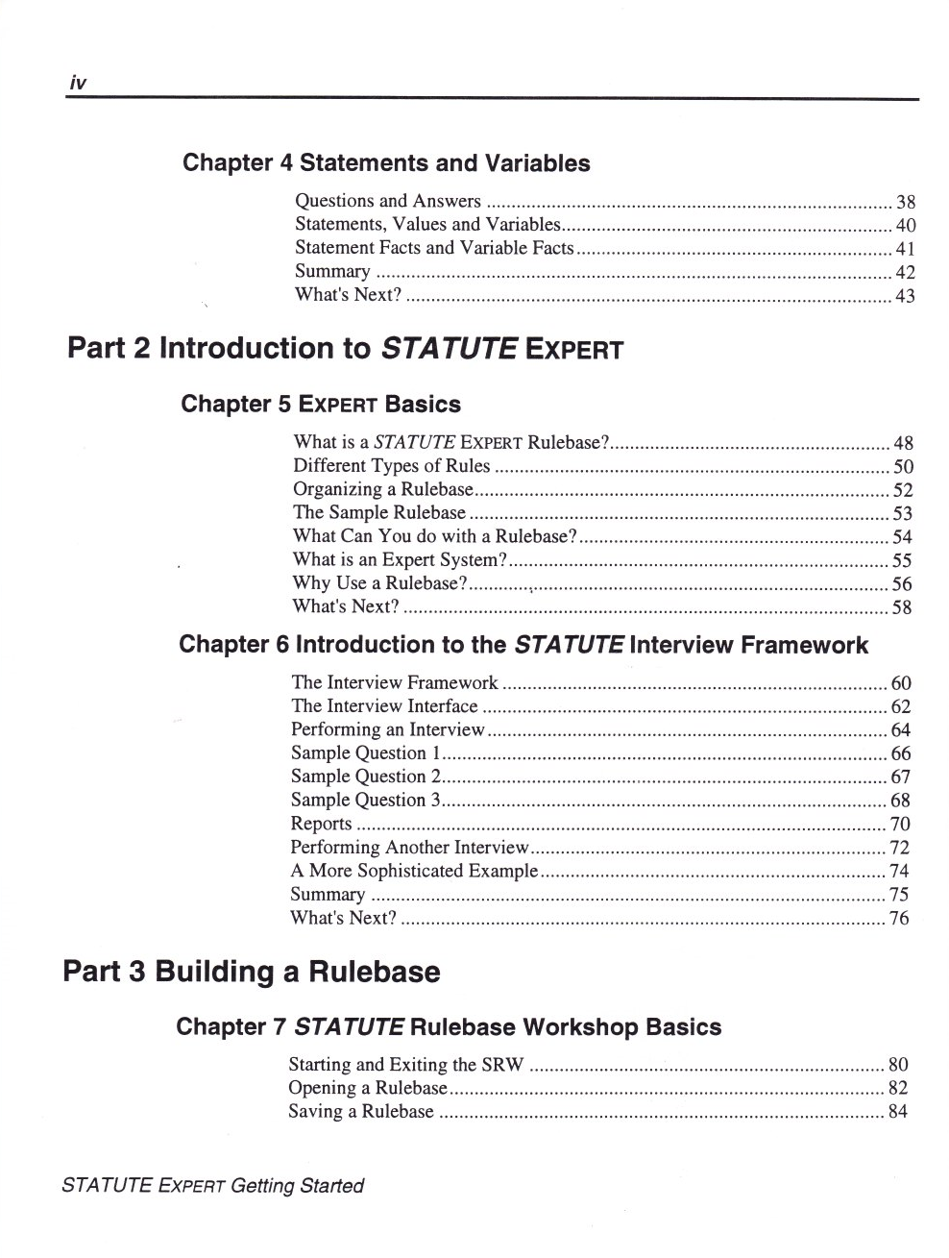
https://github.com/dsyme/ProLaLa2022/tree/main/STATUTE%20Expert
12
Notes:
[Surend]

Slide 13
STATUTE Expert Methodology
Addressed deeply practical considerations
Methodology for Modelling
Interpretation v. Legislation
Business Process Automation
Auditing Systems
Note these topics are fundamental to any practical toolchain for automating legislation
Rooted in deep experience with implementing administrative law
13
Notes:
[Surend]
Major insight was that the computer does not need to understand the English for the system to operate

Slide 14
1989-1996 – STATUTE First use cases
Claims for non fault accident compensation (New Zealand ACC)
Compensation Claims (Australian Department of Veterans Affairs)
Social Security entitlement and calculation (Australia)
Tax Law Guidance (Her Majesty’s Revenue and Customs, UK)
14
Notes:
[Surend]
7:37am

Slide 15
The Present – Oracle Intelligent Advisor

Slide 16
Demonstration
Oracle Policy Modeling

Slide 17
From a legislative toolchain to Oracle Intelligent Advisor - Technical
1989 – 1993
STATUTE Inference Machine
1994 – 2002
STATUTE Expert
2003 – 2008
RuleBurst
2009 – 2019
Oracle Policy Automation
2020 – present
Oracle Intelligent Advisor
Parsing
Boolean statements
Objects / attributes
English only
Logic
Quantification
Nullable values
Rule management
Database
Application
Question search
Decision reporting
Engine
Prolog
Parsing
Statement verbs
Object names
Partly manual
Logic
Four-state values (null and uncertain)
Application
+Name substitution
+Pronoun substitution
+Web interviews
Engine
C++ (RETE)
Parsing
+Simplified parsing
+Rule functions
+Relationship functions
Logic
+Hierarchical relationships
+Temporal reasoning
Rule management
Word/Excel documents
Application
+Application connectors
+Web services
Engine
Java/.NET (non-RETE)
Parsing
+20 non-English languages
Logic
+Many-to-many reasoning
Rule management
+Cloud deployment
Application
+Application data mapping
+Mobile app
+Chatbots
Parsing
+Further simplified parsing
Logic
+Ordering / arrays
Rule management
All cloud-based (WIP)
Application
+Process flows
Engine
JavaScript
Copyright © 2022, Oracle and/or its affiliates
Notes:
Key points of interest:
Simplified parsing
Many to many reasoning
Increasingly easy to integrate
Temporal reasoning

Slide 18
Use case applicability over time
1989 – 1993
STATUTE Inference Machine
1994 – 2002
STATUTE Expert
2003 – 2008
RuleBurst
2009 – 2019
Oracle Policy Automation
2020 – present
Oracle Intelligent Advisor
Parsing
Boolean statements
Objects / attributes
English only
Logic
Quantification
Nullable values
Rule management
Database
Application
Question search
Decision reporting
Engine
Prolog
Parsing
Statement verbs
Object names
Partly manual
Logic
Four-state values (null and uncertain)
Application
+Name substitution
+Pronoun substitution
+Web interviews
Engine
C++ (RETE)
Parsing
+Simplified parsing
+Rule functions
+Relationship functions
Logic
+Hierarchical relationships
Rule management
Word/Excel documents
Application
+Application connectors
+Web services
Engine
Java/.NET (non-RETE)
Parsing
+20 non-English languages
Logic
+Many-to-many reasoning
Rule management
+Cloud deployment
Application
+Application data mapping
+Mobile app
+Chatbots
Parsing
+Further simplified parsing
Logic
+Ordering / arrays
Rule management
All cloud-based (WIP)
Application
+Process flows
Engine
JavaScript
Government agencies (benefits, claims, tax)
+Human resources (benefits)
+Insurance companies (premiums, claims)
+Banks (regulatory compliance, risk)
+Medical devices (defect/repair compliance)
+Telecommunications (billing calculations)
+High-tech (troubleshooting, repairs)
+Retail (shipping, fees, returns)
+…
Copyright © 2022, Oracle and/or its affiliates

Slide 19
Discussion

Slide 20
Summary : Discuss!
Toolchains for legislation that find widespread adoption eventually become toolchains for automating business policy
Why? Because legislation-in-practice has strong affinity with business-policy-in-practice, and all the forces of time, cost and practicality lead any successful toolchain towards the latter
Toolchains for legislation must be grounded in limited natural language to be long-term successful
Why? Because legislation’s primary knowledge representation is natural language, its interpretation is business policy and practical isomorphism is key to maintenance

Slide 21
Papers
Primary references for Oracle Intelligent Advisor
https://bit.ly/OracleCXIA
https://bit.ly/OracleIADoc
Primary reference for STATUTE/OIA’s use of limited natural language representation
ICAIL 1991
Primary reference for STATUTE/OIA’s methodology insights
ICAIL 1993
21

Slide 22
Links
Oracle Intelligent Advisor – use it in the cloud!
Archival material and paper citations: https://github.com/dsyme/ProLaLa2022
Contact details:
Davin Fifield | LinkedIn; davin.fifield@oracle.com
Surend Dayal | LinkedIn; surend.dayal@anu.edu.au
Don Syme | LinkedIn, dsyme@microsoft.com
22

Slide 23

Questions - Audience
23

Slide 24
Thank you!
Davin Fifield – VP Product Development, Oracle
Surend Dayal – Partner, Deloitte; Senior Lecturer (Hon.), Australian National University
Don Syme – Principal Researcher, Microsoft (1998-); SoftLaw (1990-91)

Slide 25
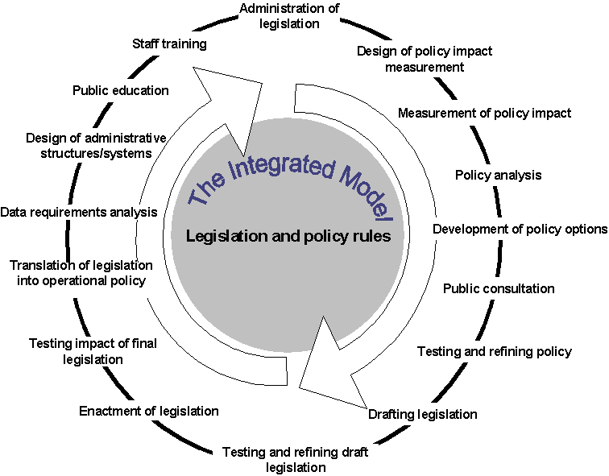
A vision for models at the heart of the legislative lifecycle
Notes:
[Surend]
Four points on the circle:
Policy Development
Accurate Policy Capture in Legislation and Software
Policy Administration
Policy Feedback loop

Slide 26
Historical challenges to widespread adoption
Separation between policy and administrative arms of government
Momentum for existing legislative/policy drafting processes
Changing the way complex rules are managed means a massive change to the way the organisation is run
Implementation Partners prefer to code in tools they already know
“Business technologists” were not yet a thing
Commercial realities drove broadening to any “business policy” modelling use cases
26

Slide 27
Summary #2
The history of STATUTE/OIA gives a practical guide to the commercial domains that have synergy with automating legislation
Why? STATUTE evolved into OIA under commercial pressures. This evolution reveals the areas that benefit from techniques that originated with automating legislation

Slide 28
Group Questions : Discuss!
What advice for a young researcher in programming languages and the law?
Is there a role for AI in the technical areas? (Parsing, Logic, Rule management, Application, Engine) How about advanced logic techniques?
How can researchers get involved in OIA today?

